Slide 1
7th Annual Future Physicians of America Survey
Erica Sniad Morgenstern, Sr. Director
Dan Van Riper, 4th year student PCOM
Milla Kviatkovsky, 3rd year student NSU

Slide 2
Executive Summary
>1,000 medical students representing all 50 U.S. states
Overall experiences in medical school are positive, but direct patient exposure is lacking
Today’s students are the most tech-savvy yet
Medical school loans are a key stress point
Future goals and aspirations for students are changing based on environmental factors

Slide 3
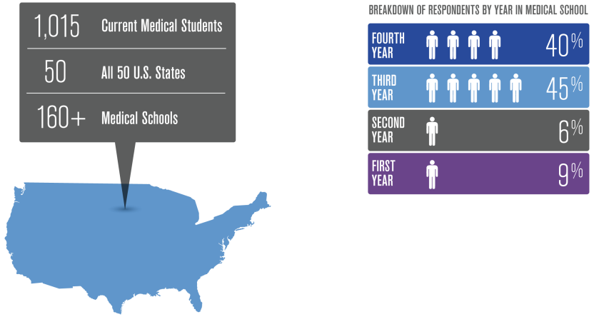
Survey Methodology
The survey was conducted exclusively online during August 2012
n = 1015

Slide 4
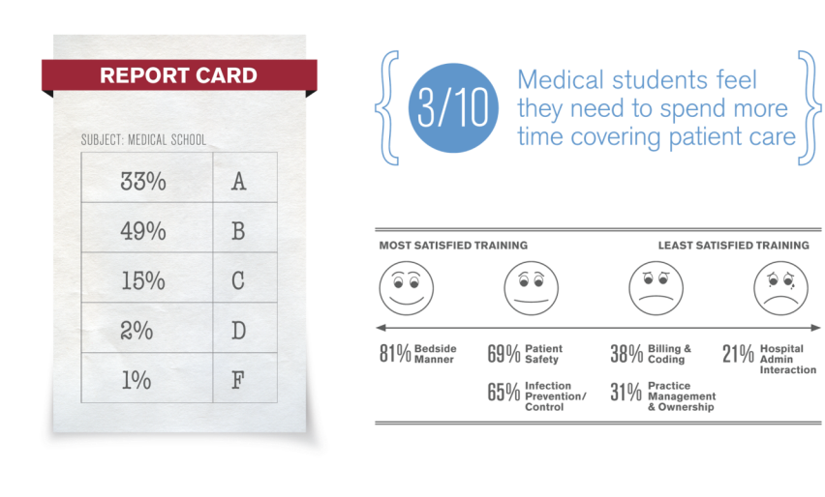
Medical School Experiences
Students rate their overall experiences at medical school positively,
but are ill-prepared for practice ownership.
n = 1015

Slide 5
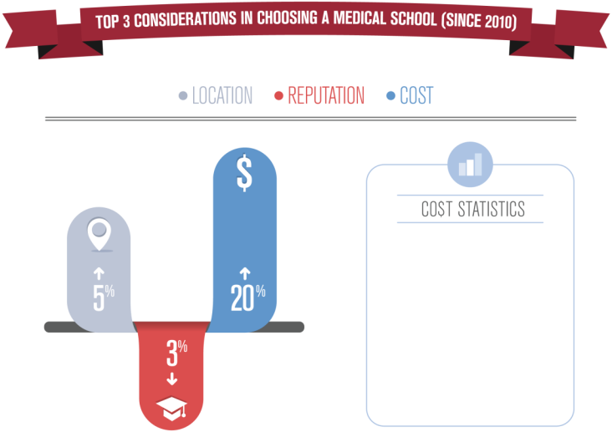
Students are Becoming More Cost Sensitive
Nearly 80% of medical students will graduate with $100,000 or more in debt¹
Medical school tuitions skyrocketed in the past 20 years (165% in private schools, 312% in public schools) ²
Average debt for young doctors is $158,000¹
http://well.blogs.nytimes.com/2011/07/28/the-hidden-costs-of-medical-student-debt/
n = 1015
Notes:
http://well.blogs.nytimes.com/2011/07/28/the-hidden-costs-of-medical-student-debt/
1 https://www.aamc.org/download/263872/data/10debtfactcard.pdf
2 http://content.healthaffairs.org/content/24/2/527.full.html

Slide 6
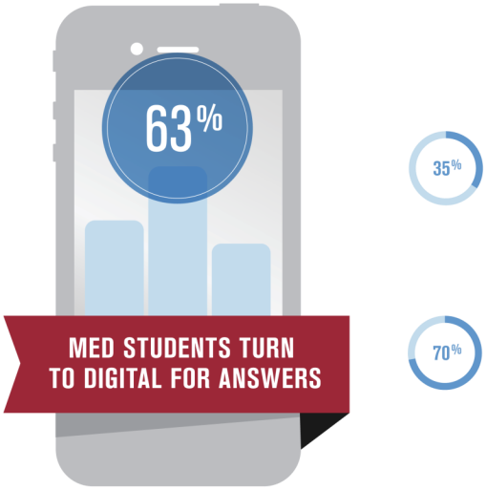
3 in 5 Turn to Digital References First for Answers
Over 35% turn to a mobile reference FIRST to answer a clinical question
70% of 3rd & 4th year students turn to Epocrates daily for clinical information
n = 1015

Slide 7
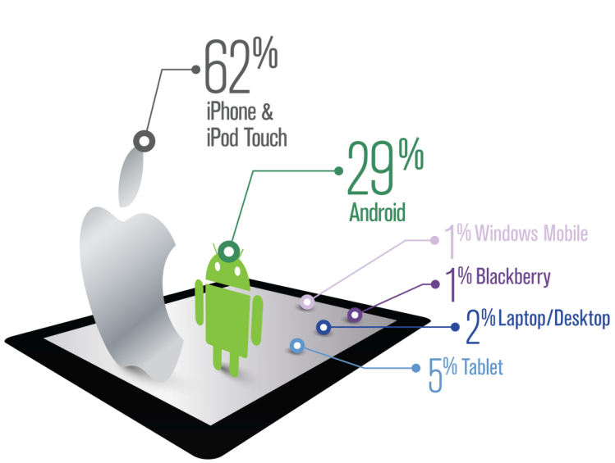
Medical Students Pick Apple
Primary mobile device usage
n = 1015

Slide 8
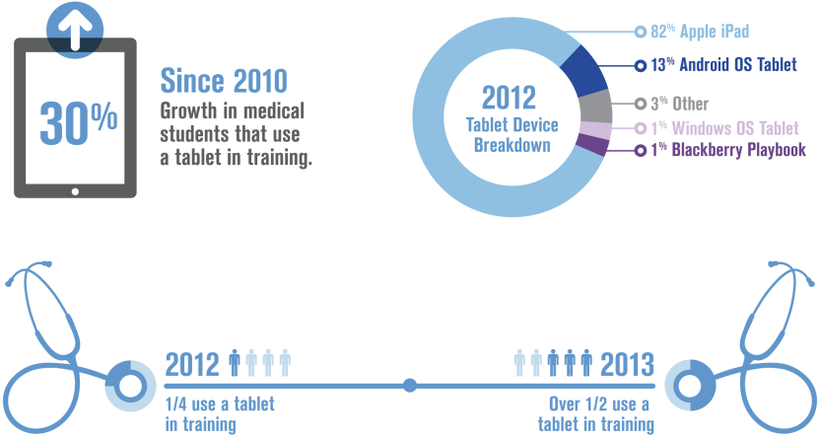
In 2013 over 50% of Medical Students Will Own a Tablet Device
n = 964
n = 747
* n =543 in 2011

Slide 9
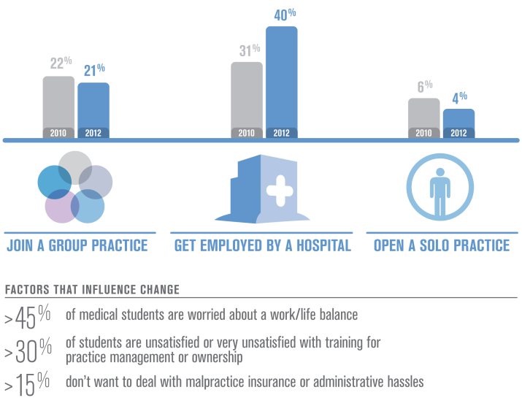
Future Employment Aspirations are Changing
n = 1015 (2012)
n = 708 (2010)

Slide 10
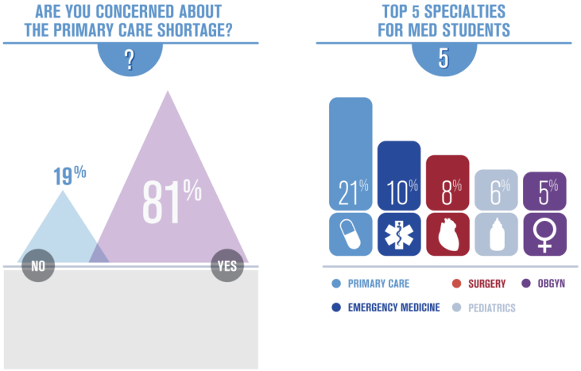
Over 80% are Concerned of the PCP Shortage
The primary care shortage has influenced nearly 40% med students choice of specialty
n = 1015

Slide 11
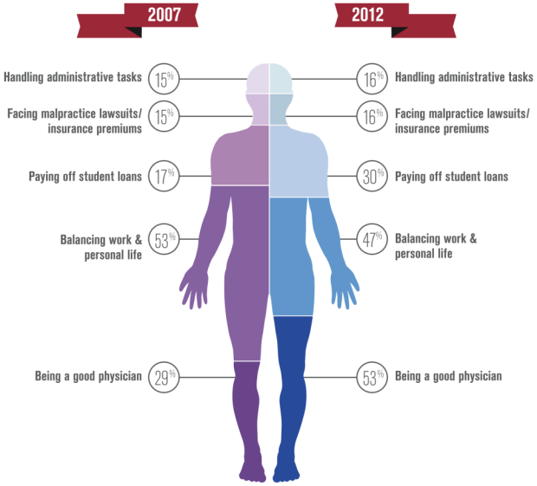
Biggest concerns of students – 2007 vs. 2012
n = 1015 (2012)
n = 1002 (2007)

Slide 12
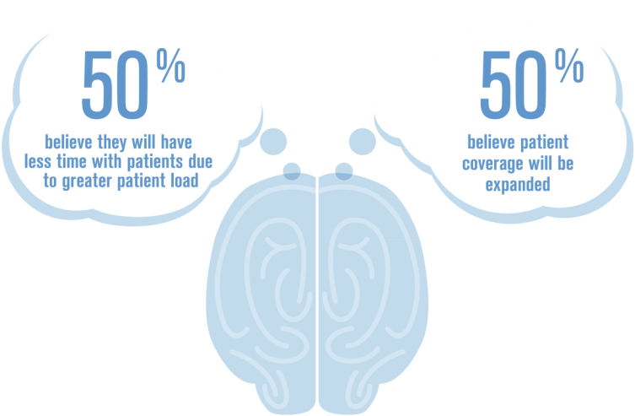
Students Divided by the Affordable Care Act
n = 1015

Slide 13
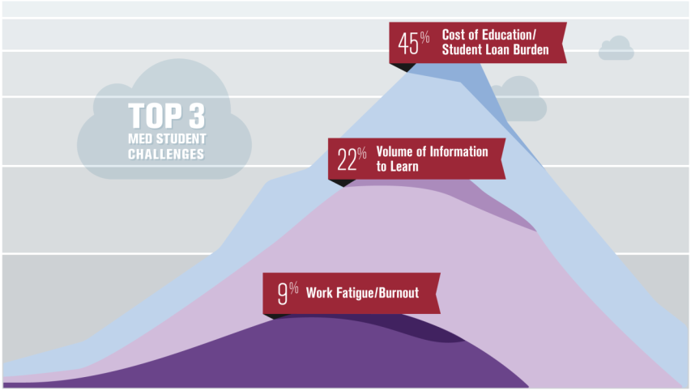
Biggest Challenges for Medical Students
n = 1015

Slide 14
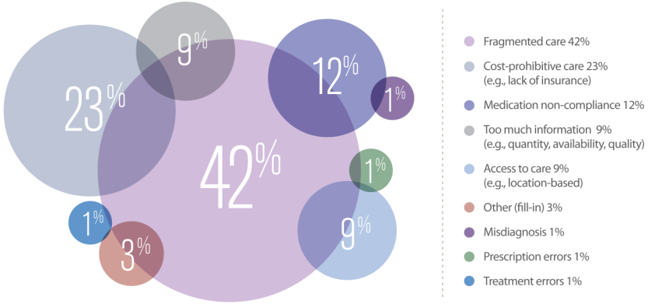
Greatest Safety Risks for Patients
n = 1015

Slide 15
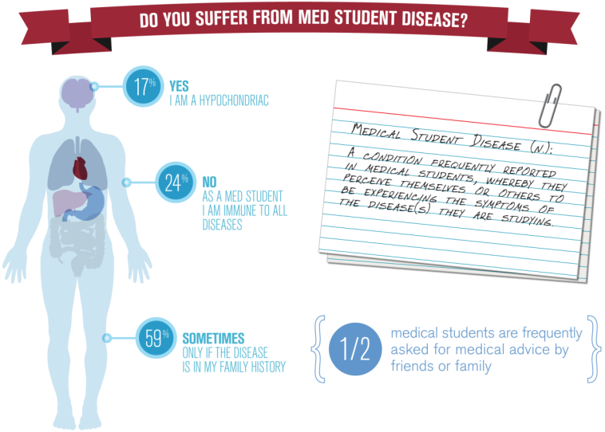
Paging Dr. Med Student
n = 1015

Slide 16
Thank you.
For a copy of this presentation, please contact PR@epocrates.com.
Copyright (C) 2012 Epocrates, Inc. All Rights Reserved. To learn more about Epocrates, please visit www.epocrates.com.

